Slide 1
Updates in COPD 2019
Dr Alia Ibrahim
MD, KBIM, MRCP, KBRF

Slide 2
Introduction
Chronic obstructive pulmonary disease (COPD) is a common respiratory condition characterized by airflow limitation.
Affects more than 5% of the population
Associated with high morbidity and mortality.
Third-ranked cause of death in the United States, killing more than 120,000 individuals each year.
As a consequence of its high prevalence and chronicity → causes
-high resource utilization
-frequent clinician office visits, frequent hospitalizations due to acute exacerbations, and the need for chronic therapy (eg, supplemental oxygen therapy, medication).

Slide 3
Establishing a correct diagnosis of COPD is important because appropriate management can →
Decrease symptoms (especially dyspnea).
Reduce the frequency and severity of exacerbations.
Improve health status, improve exercise capacity.
Prolong survival.
As current and former smokers are also at risk for a number of other medical problems for which treatment is very different, respiratory symptoms should not be attributed to COPD without appropriate evaluation and diagnosis.

Slide 4
© 2017 Global Initiative for Chronic Obstructive Lung Disease

Slide 5
GOLD Website Address
www.goldcopd.org
© 2017 Global Initiative for Chronic Obstructive Lung Disease

Slide 6
More than 3 million people died of COPD in 2012 accounting for 6% of all deaths globally.
Globally, the COPD burden is projected to increase in coming decades because of continued exposure to COPD risk factors and aging of the population.

Slide 7
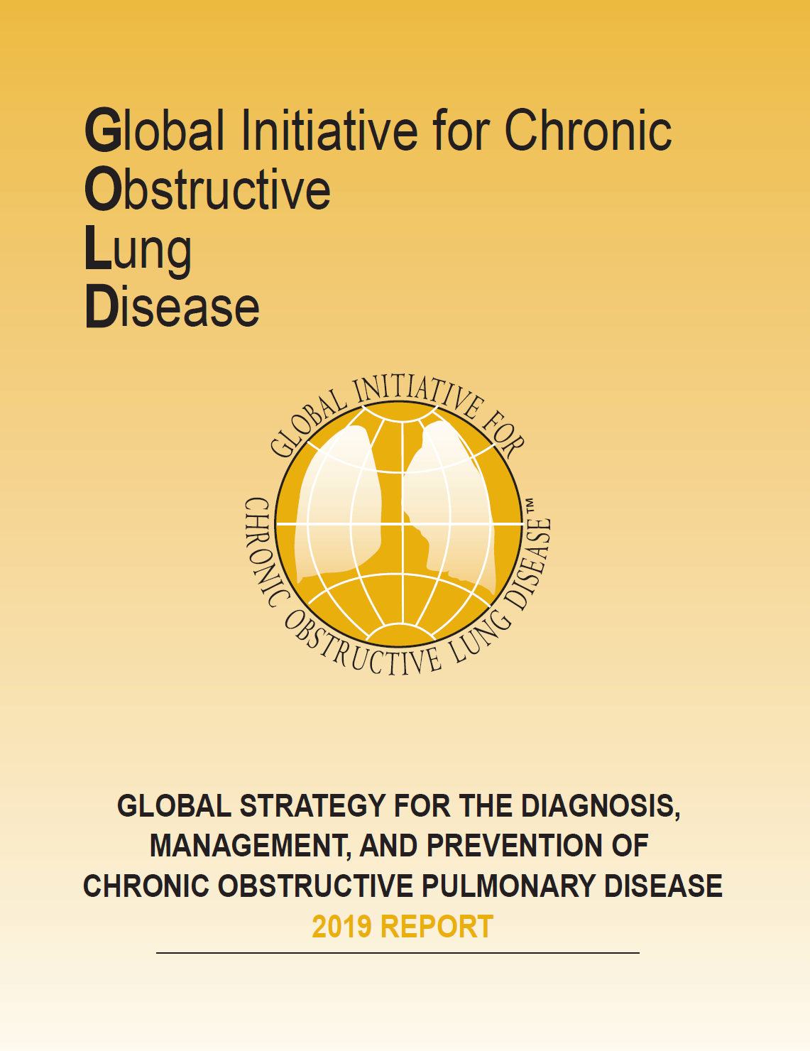
GOLD 2019 Report: Chapters
Definition and Overview
Diagnosis and Initial Assessment
Evidence Supporting Prevention & Maintenance Therapy
Management of Stable COPD
Management of Exacerbations
COPD and Comorbidities
© 2019 Global Initiative for Chronic Obstructive Lung Disease

Slide 8
GOLD 2019 Report: Chapters
Definition and Overview
Diagnosis and Initial Assessment
Evidence Supporting Prevention & Maintenance Therapy
Management of Stable COPD
Management of Exacerbations
COPD and Comorbidities
© 2019 Global Initiative for Chronic Obstructive Lung Disease

Slide 9
COPD Definition
Chronic Obstructive Pulmonary Disease (COPD) is a common, preventable and treatable disease that is characterized by persistent respiratory symptoms and airflow limitation that is due to airway and/or alveolar abnormalities usually caused by significant exposure to noxious particles or gases.
© 2019 Global Initiative for Chronic Obstructive Lung Disease

Slide 10
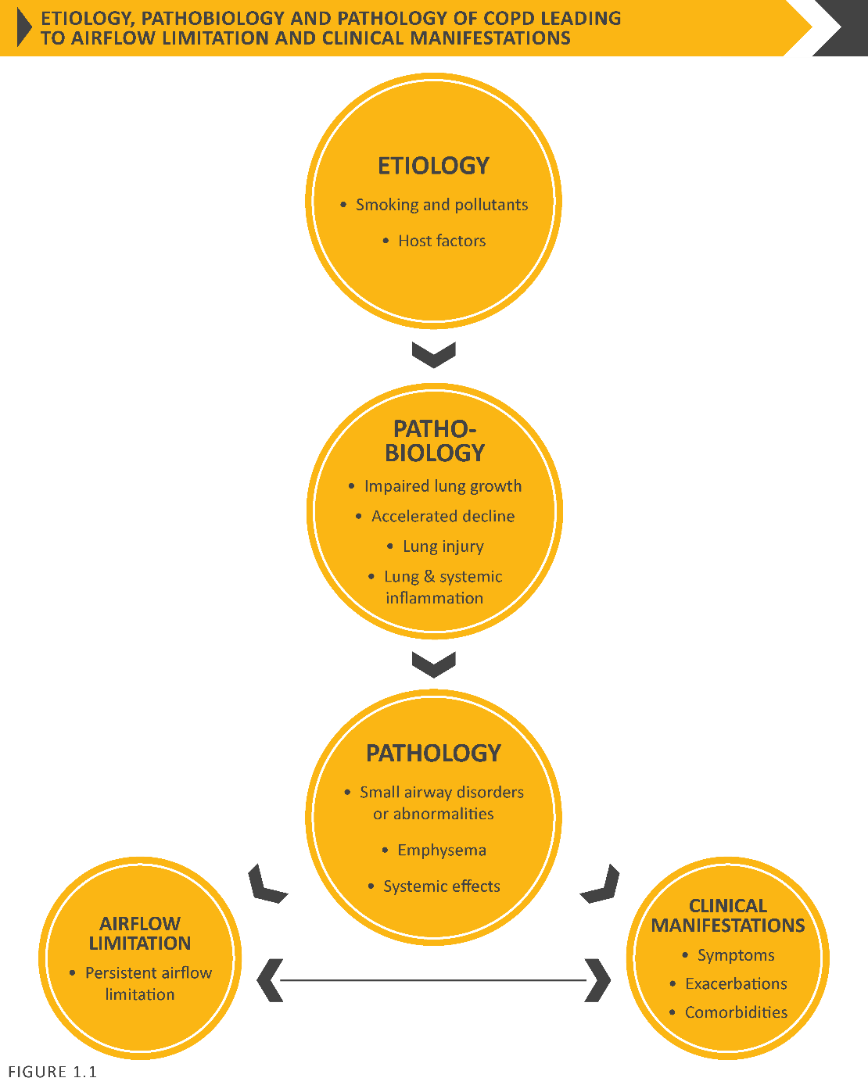
Etiology, pathobiology & pathology of COPD leading to airflow limitation & clinical manifestations
© 2019 Global Initiative for Chronic Obstructive Lung Disease

Slide 11
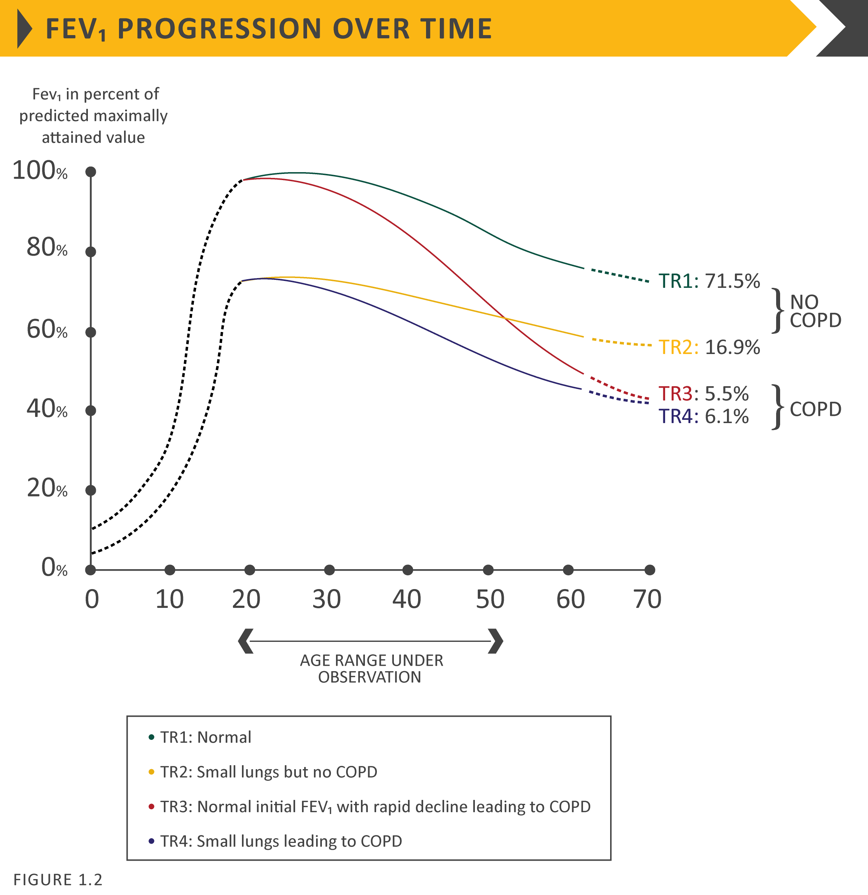
FEV₁ progression over time
© 2019 Global Initiative for Chronic Obstructive Lung Disease

Slide 12
The most common respiratory symptoms include dyspnea, cough and/or sputum production. These symptoms may be under-reported by patients.
The main risk factor for COPD is tobacco smoking but other environmental exposures such as biomass fuel exposure and air pollution may contribute.

Slide 13
Besides exposures, host factors predispose individuals to develop COPD. These include genetic abnormalities, abnormal lung development and accelerated aging.
COPD may be punctuated by periods of acute worsening of respiratory symptoms, called exacerbations.
In most patients, COPD is associated with significant concomitant chronic diseases, which increase its morbidity and mortality.
© 2019 Global Initiative for Chronic Obstructive Lung Disease

Slide 14
Prevalence
Prevalence of COPD was higher in smokers and ex-smokers compared to non-smokers
Higher in ≥ 40 year group compared to those < 40
Higher in men than women
With increasing prevalence of smoking in developing countries, and aging populations in high-income countries, the prevalence of COPD is expected to rise over the next 30 years.
Halbert et al, 2006
Notes:
Systematic review and meta-analysis ()
Included studies carried out in 28 countries between 1990 and 2004

Slide 15
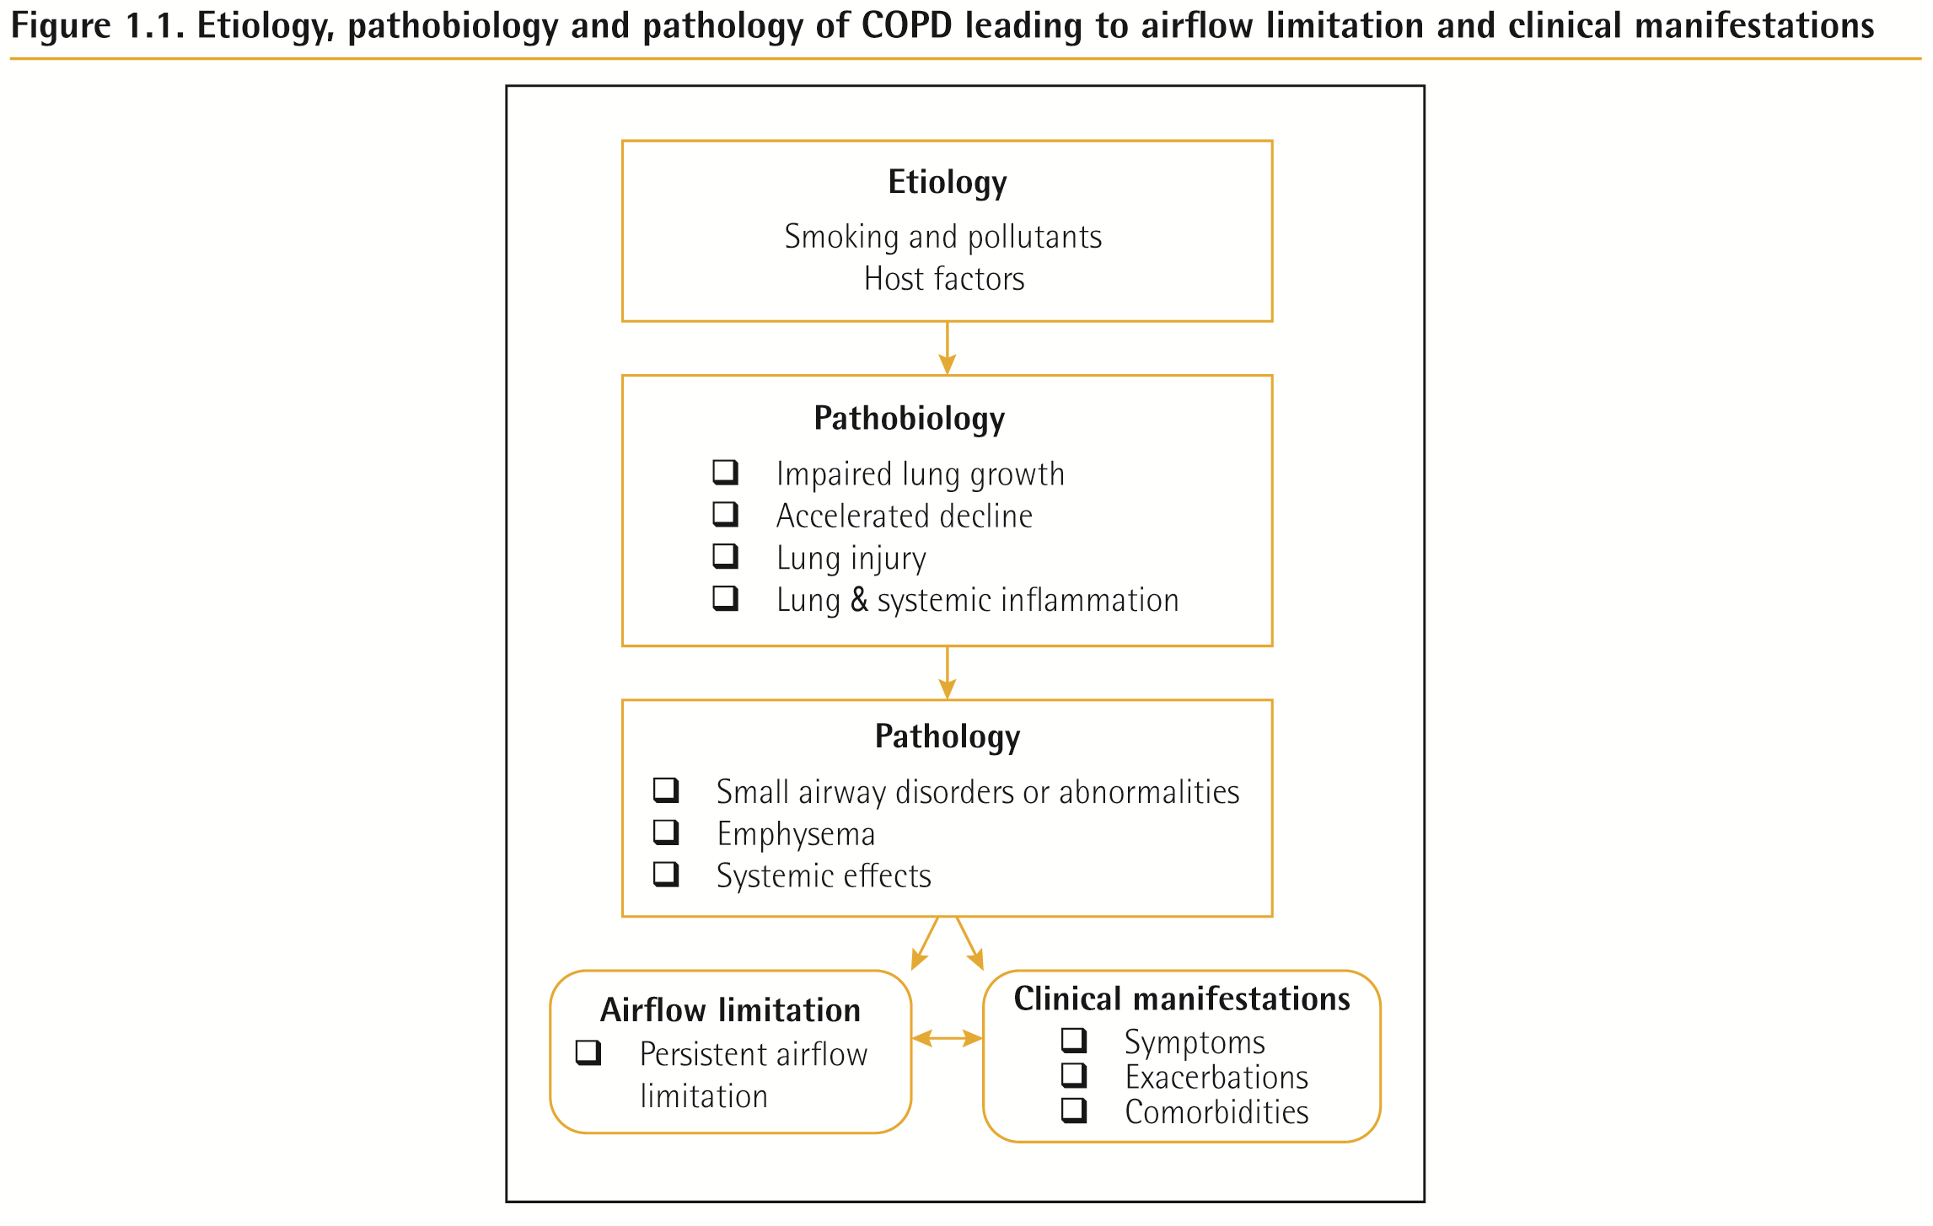
COPD Etiology, Pathobiology & Pathology

Slide 16
GOLD 2019 Report: Chapters
Definition and Overview
Diagnosis and Initial Assessment
Evidence Supporting Prevention & Maintenance Therapy
Management of Stable COPD
Management of Exacerbations
COPD and Comorbidities
© 2019 Global Initiative for Chronic Obstructive Lung Disease

Slide 17
Diagnosis and Initial Assessment
COPD should be considered in any patient who has dyspnea, chronic cough or sputum production, and/or a history of exposure to risk factors for the disease.
Spirometry is required to make the diagnosis; the presence of a post-bronchodilator FEV1/FVC < 0.70 confirms the presence of persistent airflow limitation.
The goals of COPD assessment are to determine the level of airflow limitation, the impact of disease on the patient’s health status, and the risk of future events (such as exacerbations, hospital admissions, or death), in order to guide therapy.
© 2019 Global Initiative for Chronic Obstructive Lung Disease

Slide 18
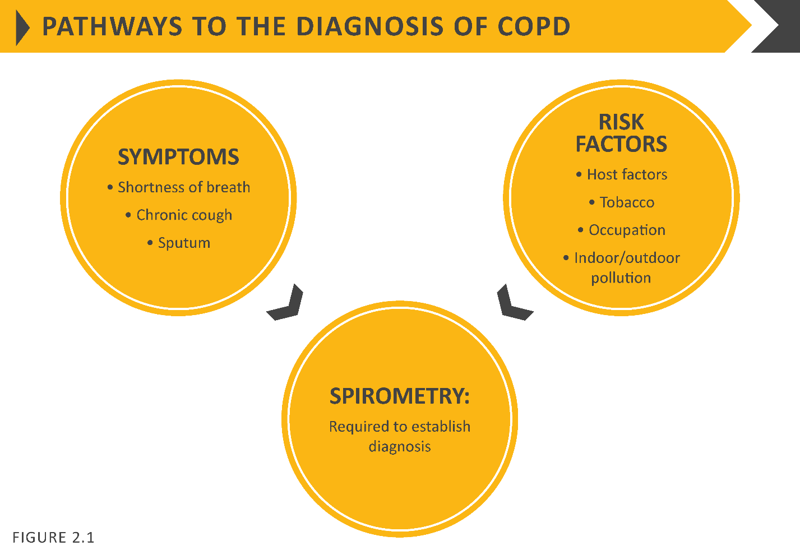
Diagnosis and Initial Assessment
© 2019 Global Initiative for Chronic Obstructive Lung Disease

Slide 19
Diagnosis and Initial Assessment
© 2019 Global Initiative for Chronic Obstructive Lung Disease

Slide 20
Diagnosis and Initial Assessment
Symptoms of COPD
Chronic and progressive dyspnea
Cough
Sputum production
Wheezing and chest tightness
Others – including fatigue, weight loss, anorexia, syncope, rib fractures, ankle swelling, depression, anxiety.

Slide 21
Diagnosis and Initial Assessment
© 2019 Global Initiative for Chronic Obstructive Lung Disease

Slide 22
Medical History
Patient’s exposure to risk factors
Past medical history
Family history of COPD or other chronic respiratory disease.
Pattern of symptom development
History of exacerbations or previous hospitalizations for respiratory disorder
Presence of comorbidities
Impact of disease on patient’s life
Social and family support available to the patient.
Possibilities for reducing risk factors, especially smoking cessation.
© 2019 Global Initiative for Chronic Obstructive Lung Disease

Slide 23
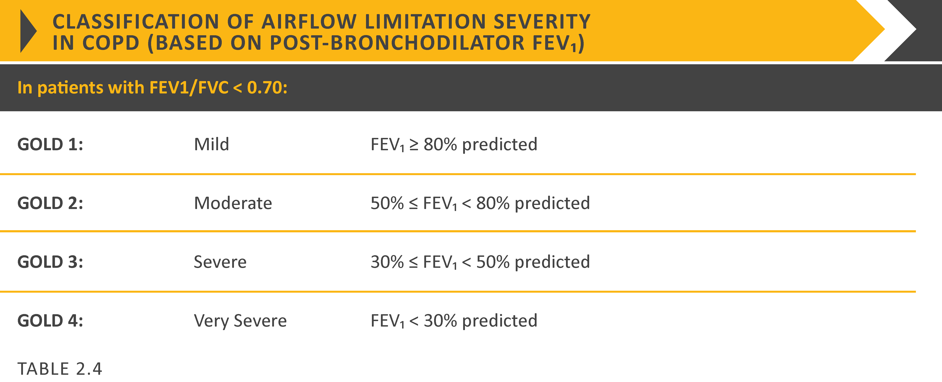
Post-bronchodilator FEV₁
© 2019 Global Initiative for Chronic Obstructive Lung Disease

Slide 24
Choice of thresholds
COPD Assessment Test (CATTM)
Chronic Respiratory Questionnaire (CCQ® )
St George’s Respiratory Questionnaire (SGRQ)
Chronic Respiratory Questionnaire (CRQ)
Modified Medical Research Council (mMRC) questionnaire
© 2019 Global Initiative for Chronic Obstructive Lung Disease

Slide 25
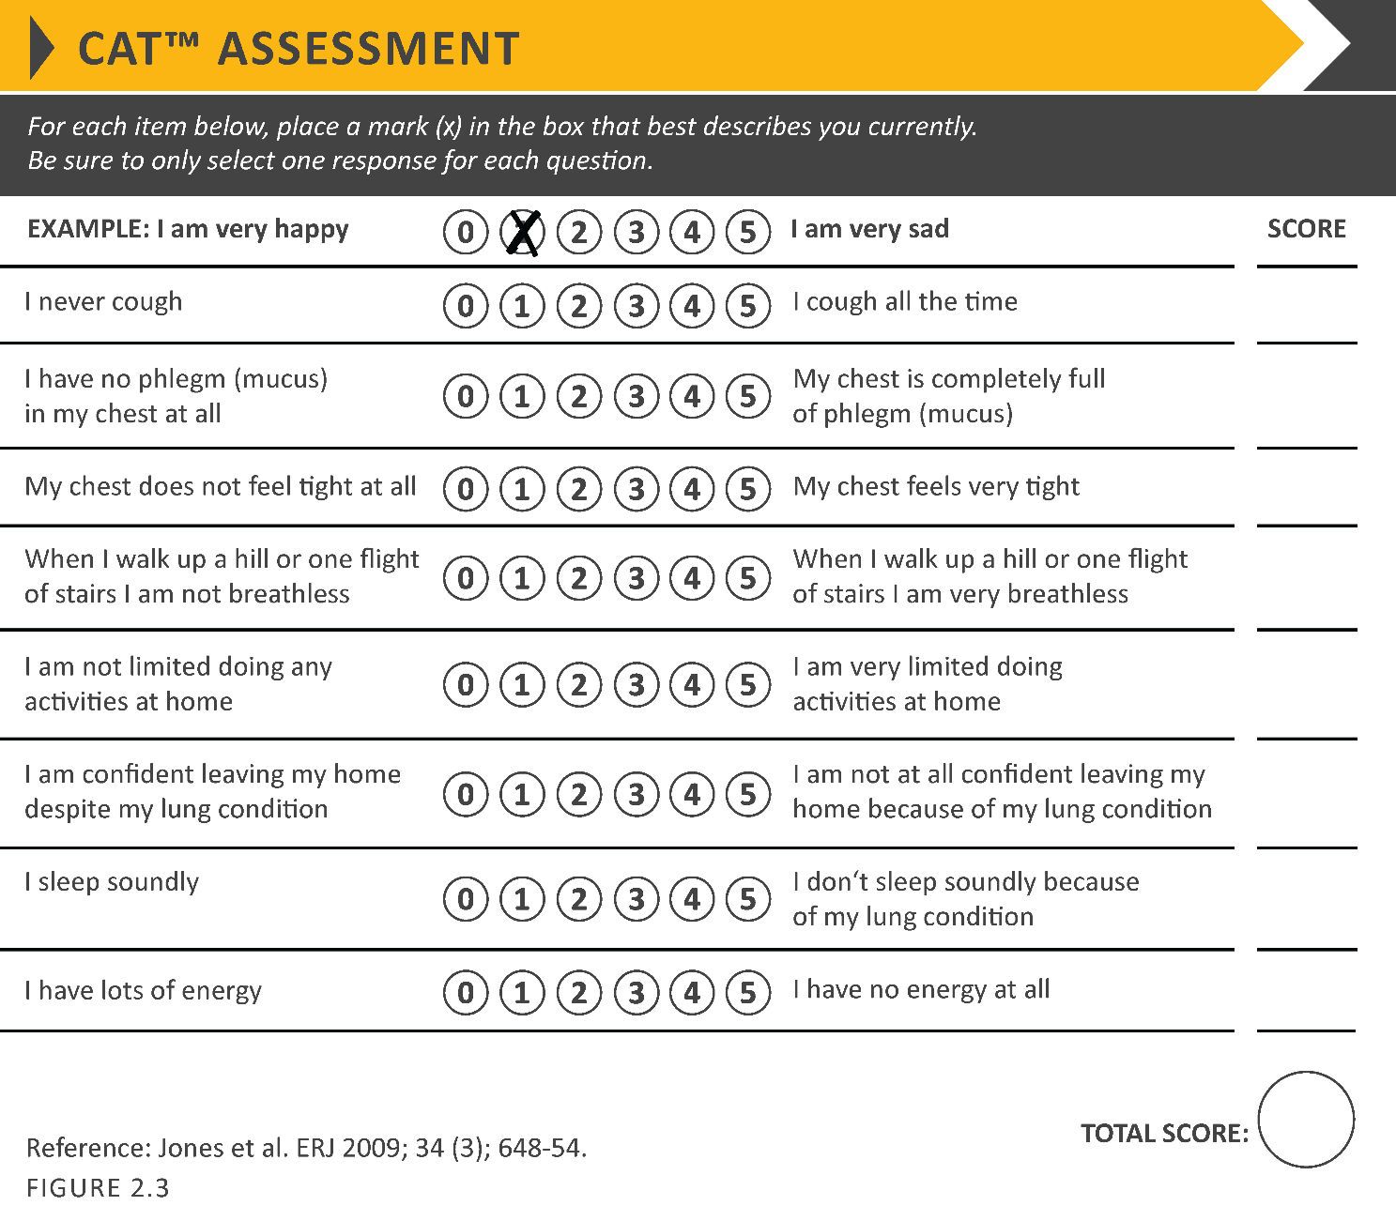
COPD Assessment Test (CATTM)
© 2019 Global Initiative for Chronic Obstructive Lung Disease

Slide 26
Modified MRC dyspnea scale
© 2019 Global Initiative for Chronic Obstructive Lung Disease

Slide 27
ABCD Assessment Tool
Example
Consider two patients:
Both patients with FEV₁ < 30% of predicted
Both with CAT scores of 18
But, one with 0 exacerbations in the past year and the other with 3 exacerbations in the past year.
Both would have been labelled GOLD D in the prior classification scheme.
With the new proposed scheme, the subject with 3 exacerbations in the past year would be labelled GOLD grade 4, group D.
The other patient, who has had no exacerbations, would be classified as GOLD grade 4, group B.
© 2019 Global Initiative for Chronic Obstructive Lung Disease

Slide 28
Summary
© 2019 Global Initiative for Chronic Obstructive Lung Disease

Slide 29
Alpha-1 antitrypsin deficiency (AATD)
AATD screening
The WHO recommends that all patients with a diagnosis of COPD should be screened once especially in areas with high AATD prevalence.
AATD patients are typically < 45 years with panlobular basal emphysema
Delay in diagnosis in older AATD patients presents as more typical distribution of emphysema (centrilobular apical).
A low concentration (< 20% normal) is highly suggestive of homozygous deficiency.
© 2019 Global Initiative for Chronic Obstructive Lung Disease

Slide 30
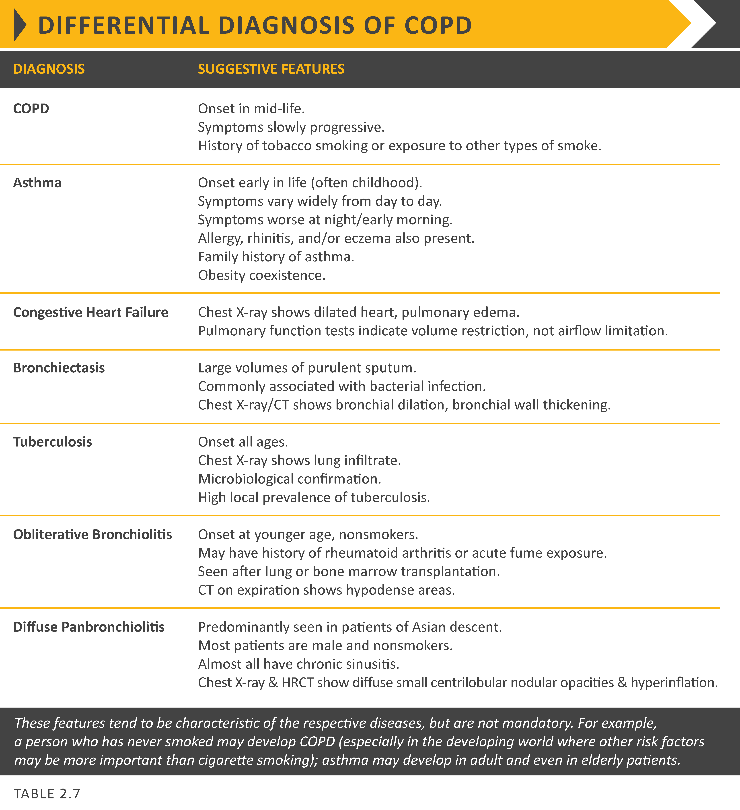
© 2019 Global Initiative for Chronic Obstructive Lung Disease

Slide 31
GOLD 2019 Report: Chapters
Definition and Overview
Diagnosis and Initial Assessment
Evidence Supporting Prevention & Maintenance Therapy
Management of Stable COPD
Management of Exacerbations
COPD and Comorbidities
© 2019 Global Initiative for Chronic Obstructive Lung Disease

Slide 32
Prevention & Maintenance Therapy
Smoking cessation: Pharmacotherapy and nicotine replacement reliably increase long-term smoking abstinence rates. Legislative smoking bans and counselling, delivered by healthcare professionals improve quit rates.
The effectiveness and safety of e-cigarettes as a smoking cessation aid is uncertain at present.
Pharmacologic therapy can reduce COPD symptoms, reduce the frequency and severity of exacerbations, and improve health status and exercise tolerance.
Each pharmacologic treatment regimen should be individualized and guided by the severity of symptoms, risk of exacerbations, side-effects, comorbidities, drug availability and cost, and the patient’s response, preference and ability to use various drug delivery devices.

Slide 33
Prevention & Maintenance Therapy
Inhaler technique needs to be assessed regularly.
Influenza vaccination decreases the incidence of lower respiratory tract infections.
Pneumococcal vaccination decreases lower respiratory tract infections.
Pulmonary rehabilitation improves symptoms, quality of life, and physical and emotional participation in everyday activities.
In patients with severe resting chronic hypoxemia, long-term oxygen therapy improves survival.
© 2019 Global Initiative for Chronic Obstructive Lung Disease

Slide 34
Smoking Cessation
Smoking cessation has the greatest capacity to influence the natural history of COPD.
If effective resources and time are dedicated to smoking cessation, long-term quit success rates of up to 25% can be achieved.
© 2019 Global Initiative for Chronic Obstructive Lung Disease

Slide 35
Vaccination
Influenza vaccination can reduce serious illness (such as lower respiratory tract infections requiring hospitalization) and death in COPD patients.
Pneumococcal vaccinations, PCV13 and PPSV23, are recommended for all patients ≥ 65 years of age.
Notes:
Pneumococcal polysaccharide vaccination (PPSV23, Pneumovax) is advised for patients under age 65 years; PPSV23 and pneumococcal conjugate vaccine (PCV13, Prevnar) are advised for patients age 65 years and older,

Slide 36
Pharmacological therapy
Overview of the medications
Pharmacological therapy for COPD is used to reduce symptoms, reduce the frequency and severity of exacerbations, and improve exercise tolerance and health status.
To date, there is no conclusive clinical trial evidence that any existing medications for COPD modify the long-term decline in lung function.
The choice within each class depends on the availability and cost of medication and favorable clinical response balanced against side effects.
Each treatment regimen needs to be individualized as the relationship between severity of symptoms, airflow limitation, and severity of exacerbations can differ between patients.
© 2019 Global Initiative for Chronic Obstructive Lung Disease

Slide 37
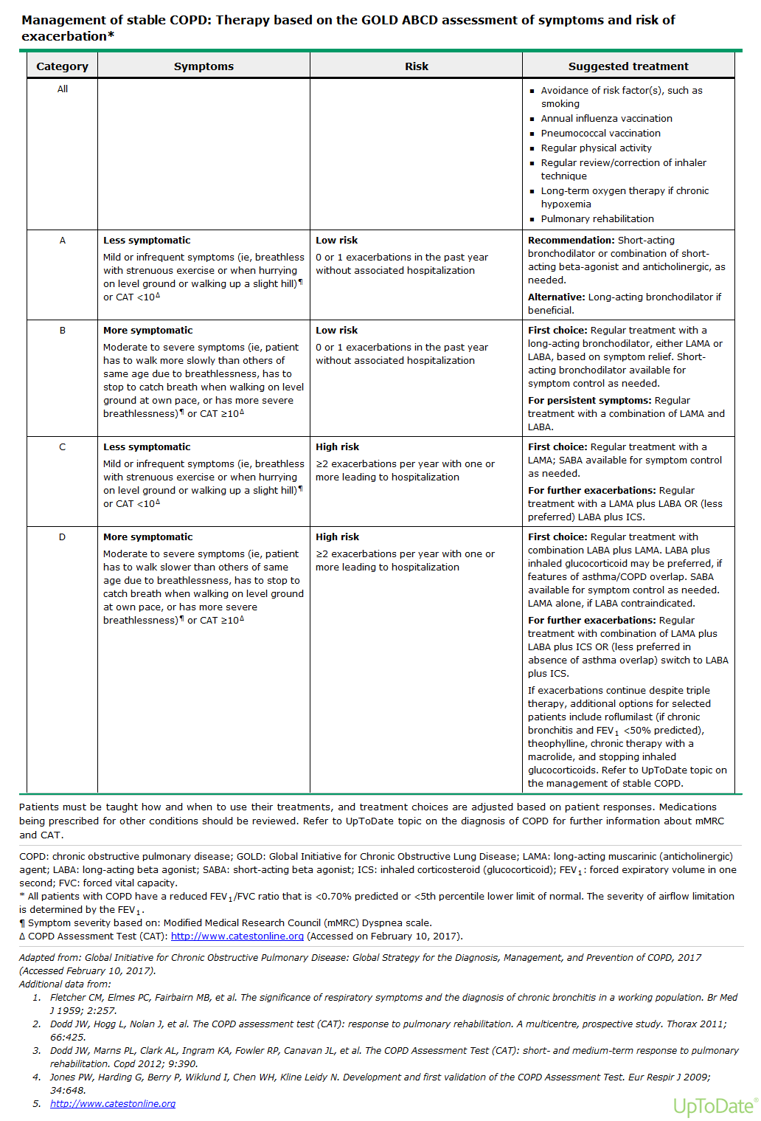

Slide 38
Pharmacological therapy
© 2019 Global Initiative for Chronic Obstructive Lung Disease

Slide 39
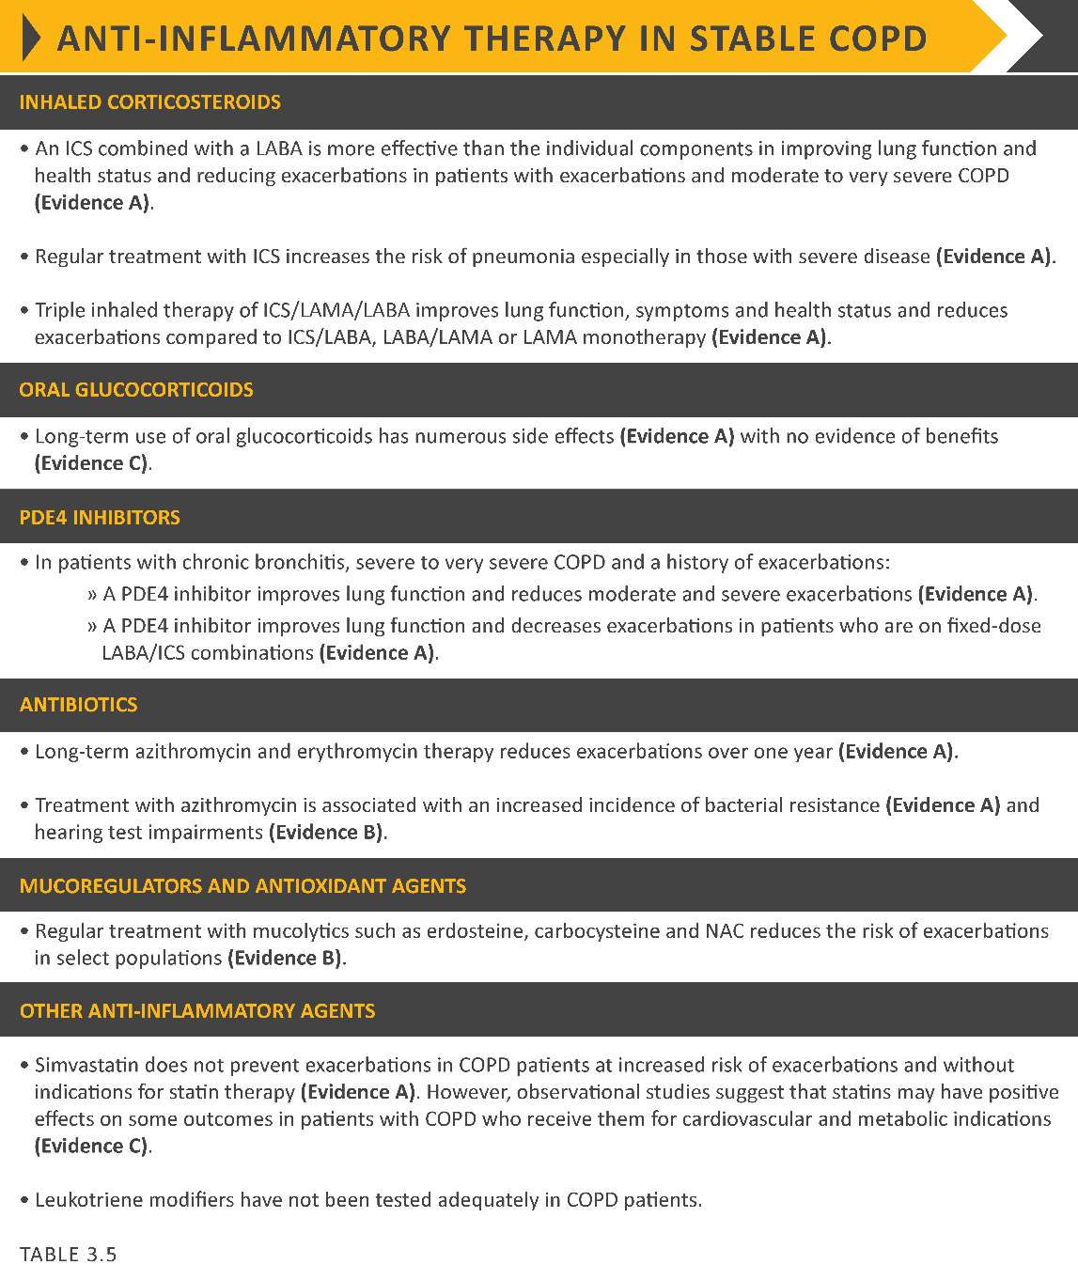
Pharmacological therapy
© 2019 Global Initiative for Chronic Obstructive Lung Disease

Slide 40
Pharmacological therapy
© 2019 Global Initiative for Chronic Obstructive Lung Disease

Slide 41
Rehabilitation, education & self-management
© 2019 Global Initiative for Chronic Obstructive Lung Disease

Slide 42
Oxygen therapy & ventilatory support
in stable COPD
During exacerbations of COPD. Noninvasive ventilation (NIV) in the form of noninvasive positive pressure ventilation (NPPV) is the standard of care for decreasing morbidity and mortality in patients hospitalized with an exacerbation of COPD and acute respiratory failure.
© 2019 Global Initiative for Chronic Obstructive Lung Disease

Slide 43
Interventional therapy in stable COPD
Lung volume reduction surgery (LVRS). LVRS is a surgical procedure in which parts of the lungs are resected to reduce hyperinflation making respiratory muscles more effective pressure generators by improving their mechanical efficiency.
© 2019 Global Initiative for Chronic Obstructive Lung Disease

Slide 44
GOLD 2019 Report: Chapters
Definition and Overview
Diagnosis and Initial Assessment
Evidence Supporting Prevention & Maintenance Therapy
Management of Stable COPD
Management of Exacerbations
COPD and Comorbidities
© 2019 Global Initiative for Chronic Obstructive Lung Disease

Slide 45
Management of stable COPD
The management strategy for stable COPD should be predominantly based on the individualized assessment of symptoms and future risk of exacerbations.
All individuals who smoke should be strongly encouraged and supported to quit.
The main treatment goals are reduction of symptoms and future risk of exacerbations.
Management strategies are not limited to pharmacologic treatments, and should be complemented by appropriate non-pharmacologic interventions.

Slide 46
Management of Stable COPD
Once COPD has been diagnosed, effective management should be based on an individualized assessment to reduce both current symptoms and future risks of exacerbations.

Slide 47
Management of Stable COPD
Identification and reduction of exposure to risk factors is important in the treatment and prevention of COPD.
Cigarette smoking is the most commonly encountered and easily identifiable risk factor for COPD, and smoking cessation should be continually encouraged for all individuals who smoke.
Reduction of total personal exposure to occupational dusts, fumes, and gases, and to indoor and outdoor air pollutants, should also be addressed.

Slide 48
Treatment of Stable COPD
Pharmacological treatment
Pharmacological therapies can reduce symptoms, and the risk and severity of exacerbations, as well as improve health status and exercise tolerance.
Most of the drugs are inhaled so proper inhaler technique is of high relevance.
© 2019 Global Initiative for Chronic Obstructive Lung Disease

Slide 49
Treatment of Stable COPD
Pharmacological treatment

Slide 50
Treatment of Stable COPD
Pharmacological treatment

Slide 51
Treatment of stable COPD
Pharmacological treatment

Slide 52
Treatment of stable COPD
Definition of abbreviations: eos: blood eosinophil count in cells per microliter; mMRC: modified Medical Research Council dyspnea questionnaire; CAT™: COPD Assessment Test™.
Notes:
All Group A patients should be offered bronchodilator treatment based on its effect on breathlessness. This can be either a short- or a long-acting bronchodilator.
This should be continued if benefit is documented.
Initial therapy should consist of a long acting bronchodilator (LABA or LAMA).
Long-acting inhaled bronchodilators are superior to short-acting bronchodilators taken as needed i.e., pro re nata (prn) and are therefore recommended.
Initial therapy should consist of a single long acting bronchodilator.
In two head-to-head comparisons the tested LAMA was superior to the LABA regarding exacerbation prevention therefore we recommend starting therapy with a LAMA in this group.
In general, therapy can be started with a LAMA as it has effects on both breathlessness and exacerbations.
For patients with more severe symptoms (order of magnitude of CAT™ ≥ 20), especially driven by greater dyspnea and/or exercise limitation, LAMA/LABA may be chosen as initial treatment based on studies with patient reported outcomes as the primary endpoint where LABA/LAMA combinations showed superior results compared to the single substances.
An advantage of LABA/LAMA over LAMA for exacerbation prevention has not been consistently demonstrated, so the decision to use LABA/LAMA as initial treatment should be guided by the level of symptoms.

Slide 53
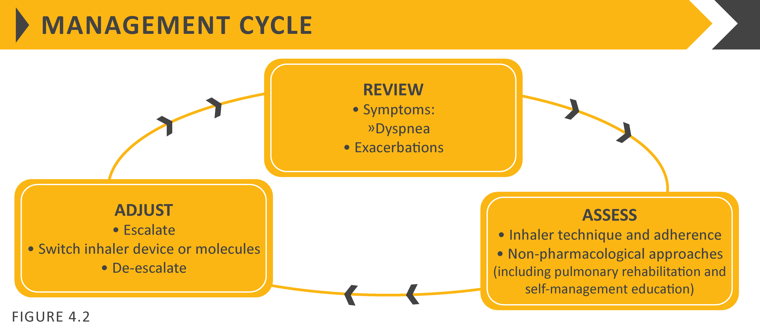
Treatment of stable COPD
Following implementation of therapy, patients should be reassessed for attainment of treatment goals and identification of any barriers for successful treatment (Figure 4.2).
Following review of the patient response to treatment initiation, adjustments in pharmacological treatment may be needed.

Slide 54
Treatment of stable COPD
Follow-up pharmacological treatment
A separate algorithm is provided for FOLLOW-UP treatment, where the management is still based on symptoms and exacerbations, but the recommendations do not depend on the patient’s GOLD group at diagnosis .
These follow-up recommendations are designed to facilitate management of patients taking maintenance treatment(s), whether early after initial treatment or after years of follow-up.
These recommendations incorporate recent evidence from clinical trials and the use of peripheral blood eosinophil counts as a biomarker to guide the use of ICS therapy for exacerbation prevention.
© 2019 Global Initiative for Chronic Obstructive Lung Disease

Slide 56
FOLLOW-UP pharmacological treatment
Follow up pharmacological management should be guided by the principles of first review and assess, then adjust if needed
Notes:
Any change in treatment requires a subsequent review of the clinical response, including side effects.
At all stages, dyspnea due to other causes (not COPD) should be investigated and treated appropriately. Inhaler technique and adherence should be considered as causes of inadequate treatment response.

Slide 57
FOLLOW-UP pharmacological treatment
Exacerbations
For patients with persistent exacerbations on long acting bronchodilator monotherapy, escalation to either LABA/LAMA or LABA/ICS is recommended. LABA/ICS may be preferred for patients with a history or findings suggestive of asthma.
Blood eosinophil counts may identify patients with a greater likelihood of a beneficial response to ICS.
For patients with one exacerbation per year, a peripheral blood level ≥ 300 eosinophils/µL identifies patients more likely to respond to LABA/ICS treatment.
For patients with ≥ 2 moderate exacerbations per year or at least one severe exacerbation requiring hospitalization in the prior year, LABA/ICS treatment can be considered at blood eosinophil counts ≥ 100 cells/µL, as ICS effects are more pronounced in patients with greater exacerbation frequency and/or severity.
Add roflumilast or azithromycin if blood eosinophils < 100 cells/µL
© 2019 Global Initiative for Chronic Obstructive Lung Disease

Slide 58
FOLLOW-UP pharmacological treatment
Exacerbations
If patients treated with LABA/LAMA/ICS who still have exacerbations the following options may be considered:
Add roflumilast. This may be considered in patients with an FEV₁ < 50% predicted and chronic bronchitis, particularly if they have experienced at least one hospitalization for an exacerbation in the previous year.
Add a macrolide. The best available evidence exists for the use of azithromycin, especially in those who are not current smokers. Consideration to the development of resistant organisms should be factored into decision-making.
Stopping ICS. This can be considered if there are adverse effects (such as pneumonia) or a reported lack of efficacy. However, a blood eosinophil count ≥ 300 cells /µL identifies patients with the greatest likelihood of experiencing more exacerbations after ICS withdrawal and who subsequently should be followed closely for relapse of exacerbations.
© 2019 Global Initiative for Chronic Obstructive Lung Disease

Slide 59
Non-Pharmacological Treatment
Education and self-management
Physical activity
Pulmonary rehabilitation programs
Exercise training
Self-management education
End of life and palliative care
Nutritional support
Vaccination
Oxygen therapy

Slide 60
Non-pharmacological treatment
Education & self-management
Self-management education and coaching by healthcare professionals should be a major component of the ‘Chronic Care Model’ within the context of the healthcare delivery system.
The aim of self-management interventions is to motivate, engage and coach the patients to positively adapt their health behavior(s) and develop skills to better manage their disease on a day-to-day basis.
Notes:
Based on GOLD groups, personalized design could include:
Groups A, B, C & D – addressing behavioral risk factors, including smoking cessation, maintaining or increasing physical activity, and ensuring adequate sleep and a healthy diet.
Groups B & D – learning to self-manage breathlessness, energy conservation techniques, and stress management strategies.
Groups C & D – avoiding aggravating factors, monitoring and managing worsening symptoms, having a written action plan and maintaining regular contact/communication with a healthcare professional.
Group D – discussing with their healthcare providers palliative strategies and advance care directives.
Influenza vaccination is recommended for all copd evidence A
Pcv13 and ppsv23 are recommended for all pts above 65 yrs or younger pts with sig comorbid diseases lung and heart dx evidence b

Slide 61
Non-pharmacological treatment
Pulmonary rehabilitation
Patients with high symptom burden and risk of exacerbations (Groups B, C and D), should be encouraged to take part in a formal rehabilitation program.
The components of pulmonary rehabilitation may vary but evidence-based best practice for program delivery includes: structured and supervised exercise training, smoking cessation, nutrition counseling, and self-management education.
© 2019 Global Initiative for Chronic Obstructive Lung Disease

Slide 62
Non-pharmacological treatment
Self-management education
The basis of enabling patients to become active partners in their ongoing care is to build knowledge and skills.
Smoking cessation
Basic information about COPD
General approach to therapy and specific aspects of medical treatment (respiratory medications and inhalation devices)
Strategies to help minimize dyspnea
Advice about when to seek help
Decision-making during exacerbations
Advance directives and end-of-life issues

Slide 63
Non-pharmacological treatment
End-of-life and palliative care
The goal of palliative care is to relieve the suffering of patients and their families by the comprehensive assessment and treatment of physical, psychosocial, and spiritual symptoms experienced by patients.
Clinicians should develop and implement methods to help patients and their families to make informed choices that are consistent with patients’ values.
Simple, structured approaches to facilitate these conversations may help to improve the occurrence and quality of communication from the patients’ perspective.

Slide 64
Non-pharmacological treatment
Notes:
Long-term oxygen therapy is indicated for stable patients who have:
PaO₂ at or below 7.3 kPa (55 mmHg) or SaO₂ at or below 88%, with or without hypercapnia confirmed twice over a three-week period; or
PaO₂ between 7.3 kPa (55 mmHg) and 8.0 kPa (60 mmHg), or SaO₂ of 88%, if there is evidence of pulmonary hypertension, peripheral edema suggesting congestive cardiac failure, or polycythemia (hematocrit > 55%).
Once placed on long-term oxygen therapy (LTOT) the patient should be re-evaluated after 60 to 90 days with repeat arterial blood gas (ABG) or oxygen saturation while inspiring the same level of oxygen or room air to determine if oxygen is therapeutic and still indicated, respectively.

Slide 65
Non-pharmacological treatment
Interventional bronchoscopy & surgery
In selected patients with heterogeneous or homogenous emphysema and significant hyperinflation refractory to optimized medical care, surgical or bronchoscopic modes of lung volume reduction (e.g., endobronchial one-way valves, lung coils or thermal ablation) may be considered.
Some of these therapies (vapor ablation and lung coils) are not widely available for clinical care in many countries.
In selected patients with a large bulla, surgical bullectomy may be considered.
In selected patients with very severe COPD and without relevant contraindications, lung transplantation may be considered.
© 2019 Global Initiative for Chronic Obstructive Lung Disease

Slide 67
Monitoring and Follow-up
Monitoring disease progression and development of complications and/or comorbidities
Measurements. Decline in FEV₁ can be tracked by spirometry performed at least once a year.
Symptoms. At each visit, information on symptoms since the last visit should be collected, including cough and sputum, breathlessness, fatigue, activity limitation, and sleep disturbances.
Exacerbations. The frequency, severity, type and likely causes of all exacerbations should be monitored.
Imaging. If there is a clear worsening of symptoms, imaging may be indicated.
Smoking status. At each visit, the current smoking status and smoke exposure should be determined followed by appropriate action.
© 2017 Global Initiative for Chronic Obstructive Lung Disease
© 2019 Global Initiative for Chronic Obstructive Lung Disease

Slide 68
Monitoring and Follow-up
Pharmacotherapy and other medical treatment
In order to adjust therapy appropriately as the disease progresses, each follow-up visit should include a discussion of the current therapeutic regimen.
Monitoring should focus on:
Dosages of prescribed medications.
Adherence to the regimen.
Inhaler technique.
Effectiveness of the current regime.
Side effects.
Treatment modifications should be recommended.
© 2017 Global Initiative for Chronic Obstructive Lung Disease
© 2019 Global Initiative for Chronic Obstructive Lung Disease

Slide 69
GOLD 2019 Report: Chapters
Definition and Overview
Diagnosis and Initial Assessment
Evidence Supporting Prevention & Maintenance Therapy
Management of Stable COPD
Management of Exacerbations
COPD and Comorbidities
© 2019 Global Initiative for Chronic Obstructive Lung Disease

Slide 70
Management of Exacerbations
OVERALL KEY POINTS (1 of 3):
An exacerbation of COPD is defined as an acute worsening of respiratory symptoms that results in additional therapy.
Exacerbations of COPD can be precipitated by several factors. The most common causes are respiratory tract infections.
The goal for treatment of COPD exacerbations is to minimize the negative impact of the current exacerbation and to prevent subsequent events.
Short-acting inhaled beta₂-agonists, with or without short-acting anticholinergics, are recommended as the initial bronchodilators to treat an acute exacerbation.
© 2019 Global Initiative for Chronic Obstructive Lung Disease

Slide 71
Management of Exacerbations
OVERALL KEY POINTS (2 of 3):
Maintenance therapy with long-acting bronchodilators should be initiated as soon as possible before hospital discharge.
Systemic corticosteroids can improve lung function (FEV₁), oxygenation and shorten recovery time and hospitalization duration. Duration of therapy should not be more than 5-7 days.
Antibiotics, when indicated, can shorten recovery time, reduce the risk of early relapse, treatment failure, and hospitalization duration. Duration of therapy should be 5-7 days.
Methylxanthines are not recommended due to increased side effect profiles.
© 2019 Global Initiative for Chronic Obstructive Lung Disease

Slide 72
Management of Exacerbations
Non-invasive mechanical ventilation should be the first mode of ventilation used in COPD patients with acute respiratory failure who have no absolute contraindication because it:
Improves gas exchange
Reduces work of breathing and the need for intubation
Decreases hospitalization duration and improves survival.
© 2019 Global Initiative for Chronic Obstructive Lung Disease

Slide 73
Management of Exacerbations
COPD exacerbations are defined as an acute worsening of respiratory symptoms that result in additional therapy.
They are classified as:
Mild (treated with short acting bronchodilators only, SABDs)
Moderate (treated with SABDs plus antibiotics and/or oral corticosteroids) or
Severe (patient requires hospitalization or visits the emergency room). Severe exacerbations may also be associated with acute respiratory failure.

Slide 74
Management of Exacerbations
Classification of hospitalized patients
No respiratory failure:
Respiratory rate: 20-30 breaths per minute; no use of accessory respiratory muscles; no changes in mental status; hypoxemia improved with supplemental oxygen given via Venturi mask 28-35% inspired oxygen (FiO₂); no increase in PaCO₂.
© 2019 Global Initiative for Chronic Obstructive Lung Disease

Slide 75
Management of Exacerbations
Classification of hospitalized patients
Acute respiratory failure — non-life-threatening: Respiratory rate: > 30 breaths per minute; using accessory respiratory muscles; no change in mental status; hypoxemia improved with supplemental oxygen via Venturi mask 25-30% FiO₂; hypercarbia i.e., PaCO₂ increased compared with baseline or elevated 50-60 mmHg.
© 2019 Global Initiative for Chronic Obstructive Lung Disease

Slide 76
Management of Exacerbations
Classification of hospitalized patients
Acute respiratory failure — life-threatening:
Respiratory rate: > 30 breaths per minute; using accessory respiratory muscles; acute changes in mental status; hypoxemia not improved with supplemental oxygen via Venturi mask or requiring FiO₂ > 40%; hypercarbia i.e., PaCO₂ increased compared with baseline or elevated > 60 mmHg or the presence of acidosis (pH ≤ 7.25).
© 2019 Global Initiative for Chronic Obstructive Lung Disease

Slide 77
Management of Exacerbations

Slide 78
Management of Exacerbations

Slide 79
Management of Exacerbations

Slide 80
Management of Exacerbations

Slide 81
Management of Exacerbations
© 2017 Global Initiative for Chronic Obstructive Lung Disease
© 2019 Global Initiative for Chronic Obstructive Lung Disease

Slide 82
Management of Exacerbations
© 2017 Global Initiative for Chronic Obstructive Lung Disease
© 2019 Global Initiative for Chronic Obstructive Lung Disease

Slide 83
TABLE 5.7 (Part I)
© 2017 Global Initiative for Chronic Obstructive Lung Disease
© 2019 Global Initiative for Chronic Obstructive Lung Disease

Slide 84
TABLE 5.7 (Part II)
© 2017 Global Initiative for Chronic Obstructive Lung Disease
© 2019 Global Initiative for Chronic Obstructive Lung Disease

Slide 85
TABLE 5.7 (Part III)
© 2017 Global Initiative for Chronic Obstructive Lung Disease
© 2019 Global Initiative for Chronic Obstructive Lung Disease

Slide 86
GOLD 2019 Report: Chapters
Definition and Overview
Diagnosis and Initial Assessment
Evidence Supporting Prevention & Maintenance Therapy
Management of Stable COPD
Management of Exacerbations
COPD and Comorbidities
© 2019 Global Initiative for Chronic Obstructive Lung Disease

Slide 87
COPD and Comorbidities
Some common comorbidities occurring in patients with COPD with stable disease include:
Cardiovascular disease (CVD)
Heart failure
Ischaemic heart disease (IHD)
Arrhythmias
Peripheral vascular disease
Hypertension
Osteoporosis
Anxiety and depression
COPD and lung cancer
Metabolic syndrome and diabetes
Gastroesophageal reflux (GERD)
Bronchiectasis
Obstructive sleep apnea
© 2019 Global Initiative for Chronic Obstructive Lung Disease
Notes:
COPD often coexists with other diseases (comorbidities) that may have a significant impact on disease course.
In general, the presence of comorbidities should not alter COPD treatment and comorbidities should be treated per usual standards regardless of the presence of COPD.
Lung cancer is frequently seen in patients with COPD and is a main cause of death.
Cardiovascular diseases are common and important comorbidities in COPD.
Osteoporosis and depression/anxiety are frequent, important comorbidities in COPD, are often under-diagnosed, and are associated with poor health status and prognosis.
Gastroesophageal reflux (GERD) is associated with an increased risk of exacerbations and poorer health status.
When COPD is part of a multimorbidity care plan, attention should be directed to ensure simplicity of treatment and to minimize polypharmacy.

Slide 88
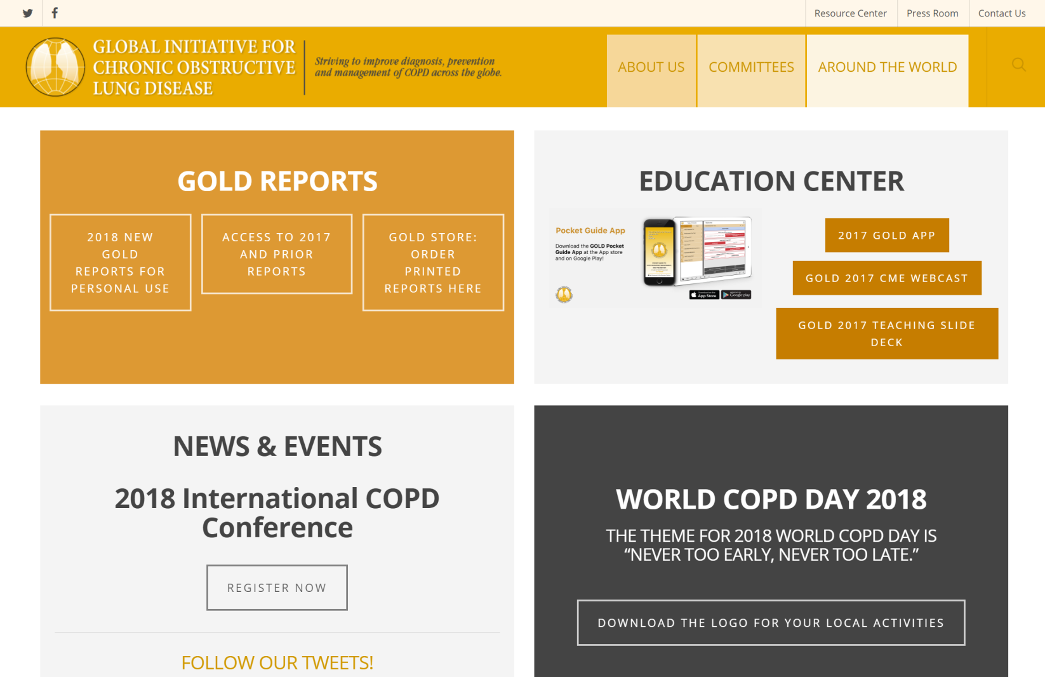
GOLD WEBSITE
www.goldcopd.org
© 2019 Global Initiative for Chronic Obstructive Lung Disease

Slide 89
WORLDCOPDDAY
Keep updated here:
© 2017 Global Initiative for Chronic Obstructive Lung Disease
© 2019 Global Initiative for Chronic Obstructive Lung Disease

Slide 90
THANK YOU
Thank you

